Slide 1

E-MAIL

Slide 2
EMAIL
E-mail stands for Electronic Mail
E-mail is an communication medium
It is one of the most widely used services of internet
It is used for sending a single message that includes text, voice, images, graphics to one or more recipients
This services allows an internet user to send a message in formatted manner
It is a fast , easy to distributive and inexpensive
Mail server handles incoming and outgoing mails
The person who is sending mail is know as sender
The person who is receives mail is know as recipient

Slide 3
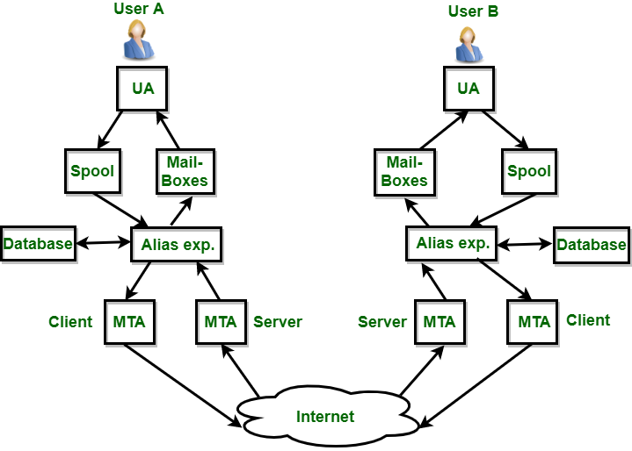

Slide 4
FOLLOWING ARE THE WAYS TO ACCESS THE MAIL:
Web based email service
Email through a LAN
Unix shell account
Using mail client
COMPONENTS:
There major components,
User agents
Mail servers
SMTP

Slide 5
USER AGENTS:
The UA is normally a program which is used to send and receive mail.
MESSAGE TRANSFER AGENT:
MTA is actually responsible for transfer of mail from one system to another.
MAILBOX : It is a file on local hard drive to collect mails. Delivered mails are present in this file.
SPOOL FILE : This file contains mails that are to be sent. User agent appends outgoing mails in this file using SMTP.

Slide 6
EMAIL ADDRESSING:
To send email to some , the internet email address must be known to sender
EX: anu@hostmail.com
The email address has two main parts, joined by @
In this EX: anu is the username
Username can be contain numbers, underscores , periods and some other special characters
Commas, spaces and parentheses are not allowed
hostmail.com is the host or domain name
email address is case insensitive
Email address do not have punctuation marks around them

Slide 7
MESSAGE HEADERS:
The message header include the addresses of the receiver and the sender
Each header consists of the type of header, a colon and the content of the header
FORMATTED EMAIL :
Email that supports formatting such as boldface and underlining is a recent development
The past, email consists only of text characters
If both side supports the formatted email , then both sides use send/ receiver formatted email

Slide 8
THE FORMATTED EMAIL COMES IN FOLLOWING TYPE:
HTML
Rich text
Multi purpose internet mail extension (MIME)
MS word format
s.no | content type | use
1 | text | Textual (document)
2 | image | Photograph
3 | audio | A sound recording
4 | video | A video recording including motion
5 | application | Raw data for program
6 | multipart | Multiple message
7 | message | An entire email message

Slide 9
FUNCTIONS OF EMAIL:
Email system support five basic functions:
Composition
Transfer
Reporting
Displaying
Disposition
USER AGENT AND MESSAGE TRANSFER AGENT:
Email system consists of two subsystems
User agent
Message transfer agent

Slide 10
USER AGENT:
It allow user to read and send email.
The user agents are local program that provide a command based or graphical method for interacting with the email system.
MESSAGE TRANSFER AGENT:
Message transfer agent to move the messages from the source to the destination.
MTA are system program that run in the background and move email through the system.

Slide 11
SIMPLE MAIL TRANSFER PROTOCOL (SMTP):
It is application layer protocol of TCP/IP model
It transfer message from senders mail servers to the recipients mail servers
It interacts with the local mail system and not the user
MULTIPURPOSE INTERNET MAIL EXTENSIONS:
MIME is supplementary protocol that allows non-ASCII data to be sent through SMTP
It allows arbitrary data to be encoded in ASCII for normal transmission

Slide 12
MIME TYPES AND SUBTYPES:
Each MIME content type must contain two identifiers
Content type
Content subtype
IMAP:
IMAP is internet mail access protocol
IMAP4 is more powerful and more complex
IMAP4 supports following modes for accessing email messages:
Offline mode
Online mode
Disconnected mode

Slide 13
OFFLINE MODE:
A client periodically connects to the server to download email messages
After downloading, messages are deleted from the server
ONLINE MODE:
Client process email messages on the server
The email messages are stored on the server itself but are processed by an application on the clients ends
DISCONNECTED MODE:
In this mode, both offline and online modes are supported

